Slide 1
Physiology of Language
Prof. Deepthi de Silva
Department of Physiology
Faculty of Medicine
Ragama
D de Silva

Slide 2
At the end of this lecture you should be able to
State the differences between the categorical (dominant) hemisphere and the representative (non dominant) hemisphere
State the main cortical areas involved in speech
State the pathway involved in understanding language, speaking and reading
Outline the basis for fluent, non fluent and global aphasia

Slide 3
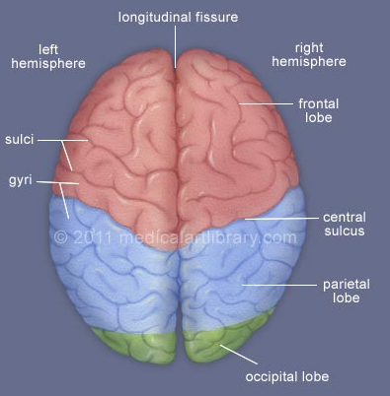
Cerebral hemispheres
Longitudinal fissure
The higher functions of the brain performed by the cerebral cortex
Look identical but have different functions
Left
Right
Frontal
lobe
sulci
Gyri
Central
sulcus
Parietal
lobe
Occipital
lobe

Slide 4
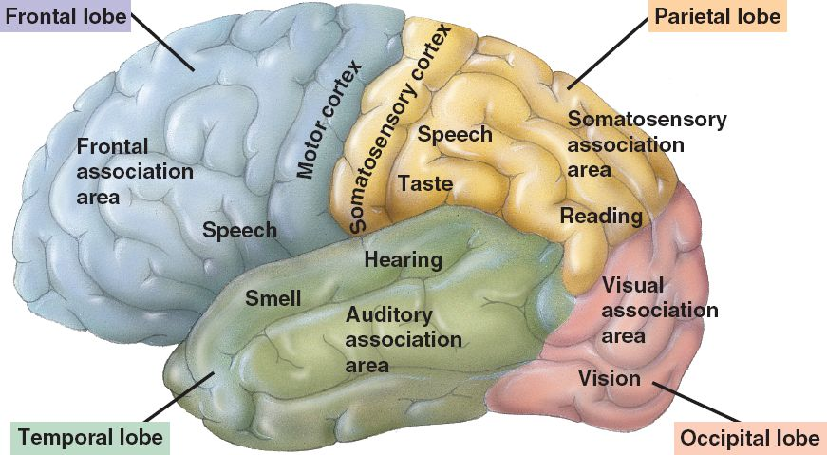

Slide 5
Cerebral hemispheres and their specialisation
Categorical hemisphere
‘Dominant hemisphere’
Left cerebral cortex
96% right handers,
70% left handers
[4% right handers &
15% left handers, right hemisphere is dominant]
Representational hemisphere
‘Non dominant
hemisphere’
Right cerebral cortex

Slide 6
Categorical hemisphere
Analytical and sequential processes
Understanding language
Representational hemisphere
Visuo-spacial relations
Remembering faces
Music
D de Silva

Slide 7
Speech :
Involves the categorical hemisphere
Wernicke area
  Posterior end of superior temporal gyrus
Broca area
  Frontal lobe anterior to lower end of motor cortex
Motor cortex
  Precentral gyrus of frontal lobe
D de Silva
Neurosciences Module

Slide 8
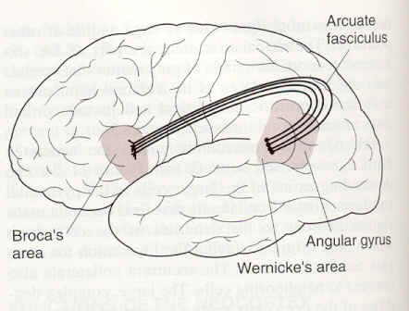
Physiology of Language
Arcuate
Fasciculus
Brocas
Area
Wernickes
Area

Slide 9
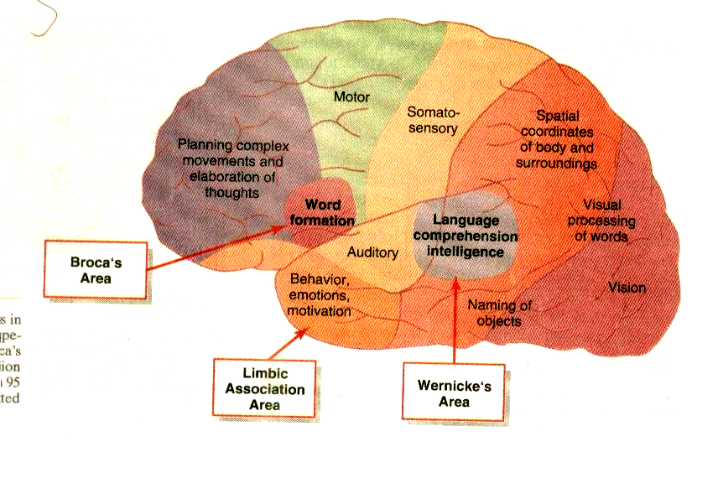
D de Silva
Neurosciences Module

Slide 10
Wernicke area
Understanding language and forming answer
Arcuate fasciculus
Broca area :
Forms detailed plan for vocalisation
Motor cortex- movements of larynx, tongue, lips
Speech

Slide 11
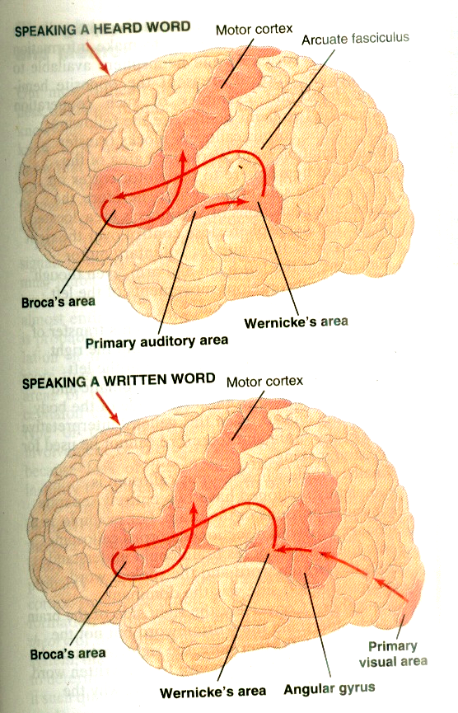
June 2009
D de Silva
Neurosciences Module

Slide 12
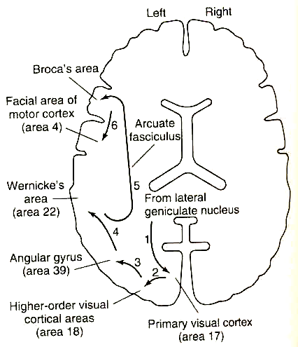
Pathway for
reading out
a word
from a
book

Slide 13
Disorders of Language
“Aphasias”
‘Abnormal language function not related to visual, hearing or motor paralysis’
Secondary to lesions of the dominant (categorical) hemisphere
D de Silva

Slide 14
Fluent Aphasia
[Receptive aphasia]
Can produce words BUT they have little meaning
Difficulty in the comprehension of written and spoken language
Lesion of Wernicke area
D de Silva

Slide 15
Non Fluent Aphasia
[Expressive Aphasia]
Lesion of Broca area
Speech slow and words formation is difficult
Can comprehend written and spoken language
D de Silva

Slide 16
Global Aphasia
Associated with more generalised damage to categorical hemisphere
Reduced quantity and quality of speech (both receptive and expressive speech affected)
D de Silva

Slide 17
Rare aphasias
Conductive aphasia
  Inability to put parts of words together
  Lesion around auditory cortex
Anomic aphasia
  Can understand speech and speak
  Difficulty understanding words/pictures
  Lesion angular gyrus
D de Silva

Slide 18
Lesions of the Representational Hemisphere
Cause Agnosia (parietal lobe damage)
  Inability to recognise an object even when sensory system is working
  E.g. astereognosis
Can cause inattention or neglect of the contralateral part of the body
Inability to recognise faces
  Right inferior temporal lobe lesions
D de Silva

Slide 19
Can you?
State the differences between the categorical (dominant) hemisphere and the representative (non dominant) hemisphere
State the main cortical areas involved in speech
State the pathway involved in understanding language, speaking and reading
Outline the basis for fluent, non fluent and global aphasia
D de Silva
Neurosciences Module

